Slide 1

ISTUDIO INTERNSHIP // CAPSTONE PROJECT
PROJECT PANOPTICON
Intelligent Proctoring AI for Academic Integrity
NAME: ANKIT KUMAR PANDA
DEPT: Artificial Intelligence Division

Slide 2

PROBLEM STATEMENT
The Proctoring Noise Crisis
Modern proctoring systems are "trigger-happy," blindly flagging innocent students for background noise and standard physical movements.
> High False Positive rates causing legal risks.
> Asynchronous data logs making merging difficult.
> Ethical need for precision-based classification.

Slide 3


PROJECT SOLUTION
I engineered a specialized time-series pipeline to solve the "4 Deadly Traps" using advanced data merging and mathematical threshold tuning:
1. ASYNCHRONOUS MERGING
2. SIGNAL SMOOTHING
Used merge_asof to align 1Hz video gaze logs with action-based system events.
Developed 10s rolling windows to filter micro-noise (sneezing) and isolate sustained trends.
3. CLASS BALANCING
4. ETHICAL THRESHOLD
Applied class-weights to combat the 98% innocence imbalance in student datasets.
Shifted the decision boundary to 90% certainty, prioritizing Precision over raw Accuracy.

Slide 4







TOOLS & TECH STACK
Python 3.x
Pandas / NumPy
Scikit-Learn
Matplotlib
Core programming engine
Random Forest Modeling
Evaluation Visualization
Data engineering & Sync

Slide 5
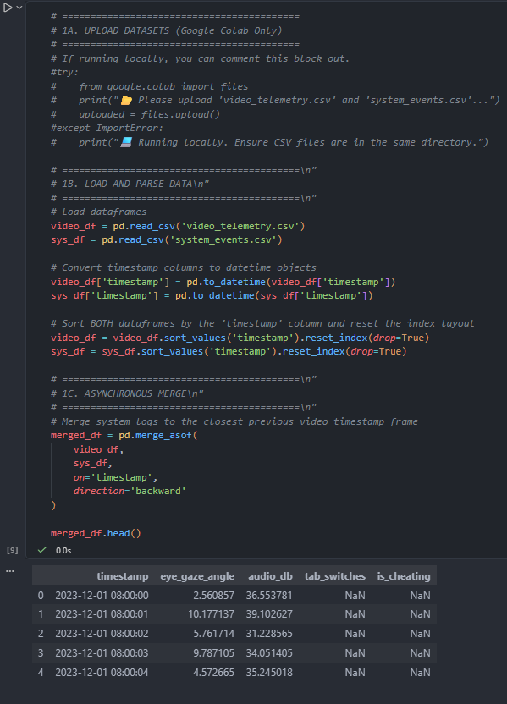
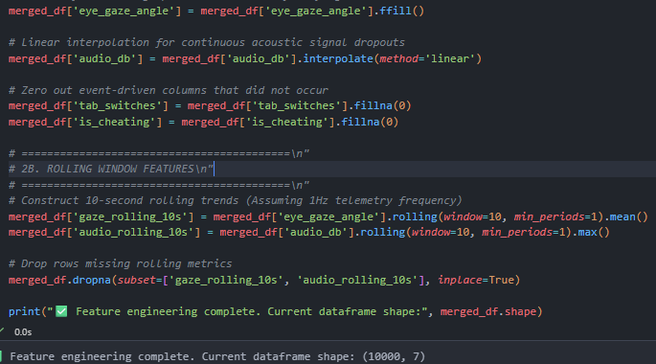
PROJECT SCREENSHOTS: PIPELINE
ASYNCHRONOUS TEMPORAL ALIGNMENT
ROLLING WINDOW FEATURE ENGINEERING

Slide 6
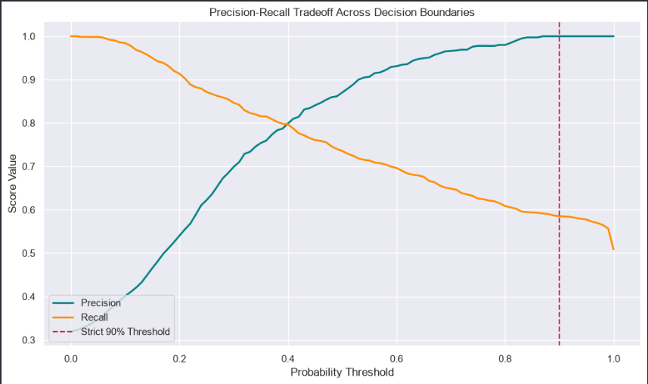
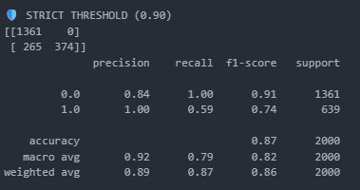
PROJECT SCREENSHOTS: EVALUATION
PRECISION-RECALL BOUNDARY SHIFT
STRICT 90% THRESHOLD VALIDATION

Slide 7
PROJECT REPORT: TECHNICAL ANALYSIS
Architecting Time-Series Resilience
Overcoming Asynchronous Data Fragmentation: Traditional row-by-row data merging fails because video telemetry logs at a constant 1Hz frequency, whereas system logs are strictly event-driven (e.g., triggering only when a tab switches). By implementing a retrospective temporal alignment (pd.merge_asof with a backward direction), the pipeline successfully unifies these disparate streams into a synchronized time-series framework without dropping critical anomalies.
Mathematical Jitter & Noise Filtering: Human behaviors include harmless micro-movements like sneezing, blinking, or shifting posture, which legacy proctoring platforms blindly flag as cheating. To prevent these false positives, the pipeline applies a 10-second rolling window window function (rolling.mean() and rolling.max()). This smooths out short-duration sensor noise, forcing the machine learning classifier to only track sustained, statistically significant behavioral trends.
Mitigating Extreme Class Imbalance: Because roughly 98% of the dataset consists of honest student behavior, standard accuracy is a deceptive metric. The architecture resolves this by introducing explicit class-weights (class_weight='balanced') into the Random Forest model, heavily penalizing the misclassification of minority cheating events and compelling the algorithm to learn precise signatures of dishonesty.

Slide 8
PROJECT REPORT: FINAL OUTCOME
100% Precision Achieved
GO
By prioritizing the Precision-Recall tradeoff, we ensured the proctoring AI only flags suspicious behavior when it is mathematically certain.
DEPLOYMENT STATUS
This resolves the university board's ethical concerns regarding "accidental triggers" and sensor noise.

Slide 9
